Slide 1
Canadian International Development Agency
Yuhan Li, Yijun Huang, & Yufei Song

Slide 2
Outline
动画
视频
互动
History of the organization
Mission Statement
Governance
Funding
Employment opportunities
Trajectory of further education
Critical Analysis of value & sustainability

Slide 3

History
The Canadian International Development Agency (CIDA) is an organization that was founded in 1968 under the leadership of Lester B. Pearson, who was by then the Prime Minister of Canada. This federal government agency was tasked with the administration of most of Canada’s official co-operation programs majorly in the countries that were undergoing transition and the developing countries. During its formation, CIDA was under the Department of Foreign Affairs, Trade, and Development.

Slide 4
Mission Statement
CIDA supports sustainable development activities in order to reduce poverty and to contribute to a more secure, equitable and prosperous world. Development is a complex, long-term process that involves all of the world's people, governments and organizations at all levels. Working with partners in the private and public sectors in Canada and in developing countries, and with international organizations and agencies, we support foreign aid projects in more than 100 of the poorest countries of the world. The objective: to work with developing countries and countries in transition to develop the tools to eventually meet their own needs (Canadian International Development Agency).

Slide 5
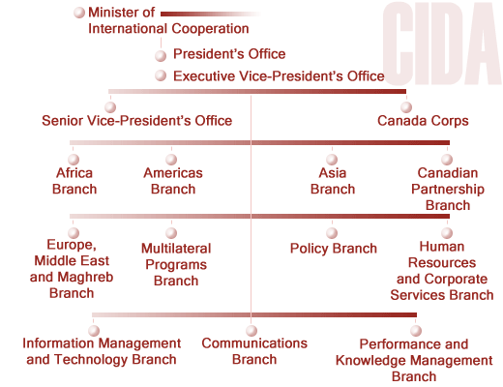
Governance

Slide 6
Funding

Slide 7
Employment opportunities

Slide 8
Trajectory of further education

Slide 9
Critical Analysis of value & sustainability

Slide 11
References

